Slide 1
ETL - JAM
February 23rd 2020
Rand Barclay, Will Giordano, Paul Kazalski

Slide 2
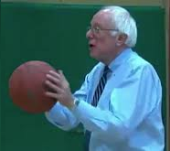
Project Scope
An NBA game commonly has an unequal distribution of points among team players
We investigate:
Is this an NBA trend or is this point distribution general to basketball?
Does a higher inequality of points contribute to more winning?
Our proposal:
G_{P} represents the point maldistribution for a team.
Compare G_{P}’s to teams within a league
Compare G_{P}’s of the NBA to G_{B} in other leagues
Compare the G_{P}’s of the NBA over time.
Pictured: Bernie Sanders, A U.S. senator who scorns inequality of wealth, playing basketball. But how does he feel about unequal point distributions??

Slide 3
G_{P} , the Gini Coefficient of Points
Gini coefficients are used to determine how unequal a distribution is.
The graph shows to cumulative distribution functions (cdfs) of points in a typical basketball game.
Blue: the cdf of sample data, shown below
Orange: the cdf of a team that has a perfectly even distribution of points.
Gp measures the ratio between the two cdfs

Slide 4

Mathematics for G_{P}
$$G_{P }=1 − \frac{(data area −\min{area)}}{(perfect area −\min{area)}}$$
$$Min Area= \frac{1}{\# players}$$
$$Data Area=\sum{\frac{1}{\# players}∗\sum_{i=1}^{n}{\frac{P_{i}}{total P}}}$$
$$Perfect Area=\sum{\frac{1}{\# players}∗\sum_{i=1}^{n}{i∗\frac{1}{\# players}}}$$

Slide 5
Data Sources
Data comes from https://www.basketball-reference.com/
WNBA data comes from https://www.basketball-reference.com/wnba/years/XXXX_per_game.html
XXXX is a year of our choosing
NBA data comes from https://www.basketball-reference.com/leagues/NBA_XXXX_per_game.html
XXXX is a year of our choosing
G-league data comes from https://www.basketball-reference.com/gleague/teams/YYY/XXXX.html
YYY is a team of our choosing and XXXX is a year of our choosing

Slide 6
Data ETL Methods
All data scraped using BeautifulSoup
Data is transferred using Pandas
Written into .csv files as redundant data storage method
Data loaded into MongoDB
There may be exceptions to our data – injuries, trades, load management, that make unstructured databases desirable

Slide 7
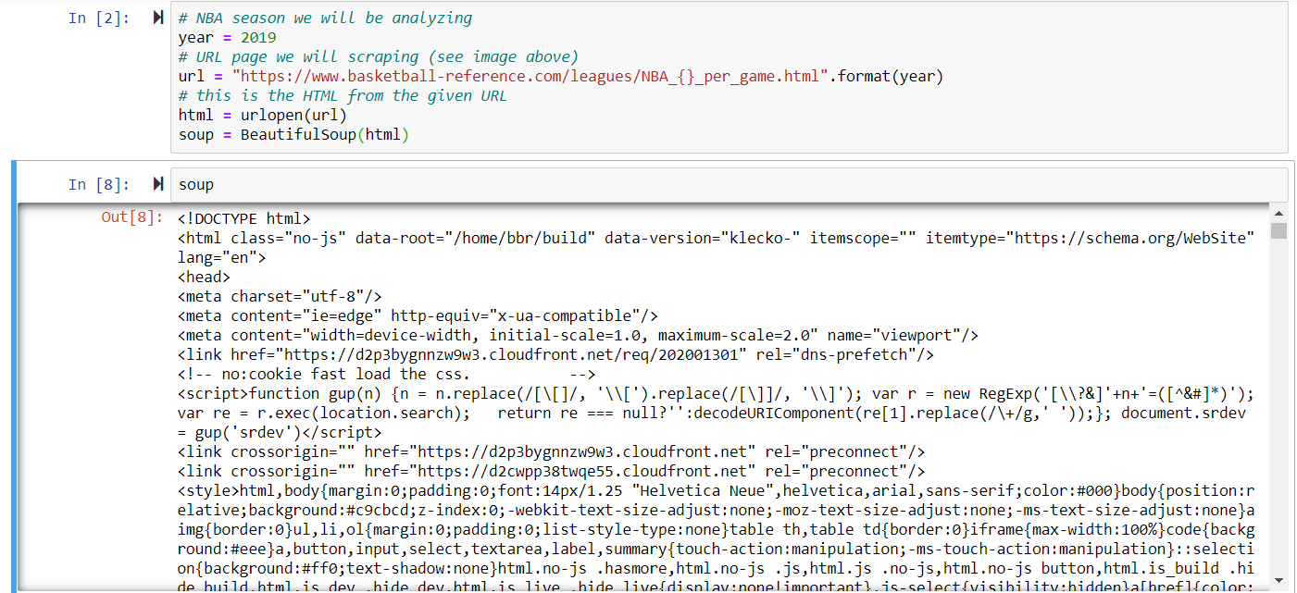
Beautiful Soup Output

Slide 8
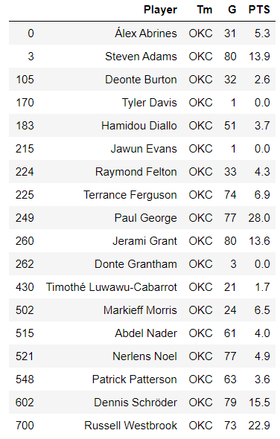
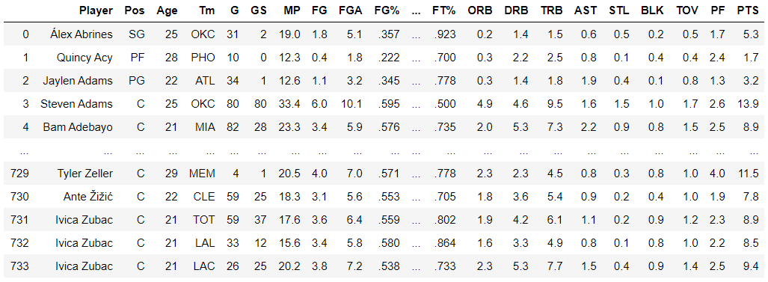
Pandas DataFrame Output
Duplicate names happen during trades.
This doesn’t impact our results when we create
DataFrames per team.

Slide 9
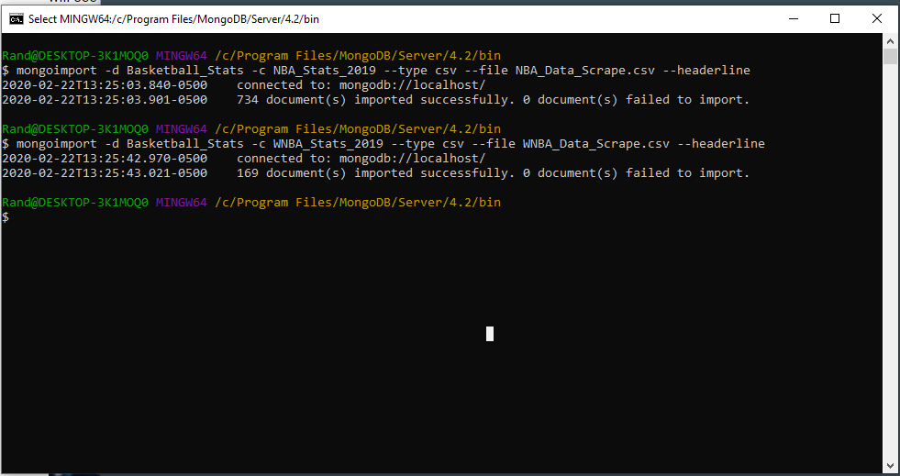
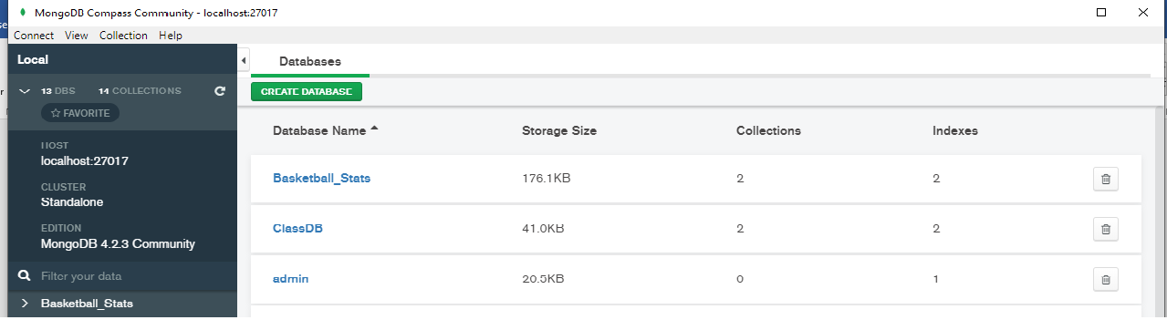
MongoDB Input

